Slide 1
Current clear-to-trade process
Dynamic requirements determine what runs; non-dependent fulfilment starts early; readiness is continuously reassessed and published as structured state
TRIGGER
New relationship • product / service extension • material client / ownership / risk change • refresh / reassessment
Decision
gate
Legend:
Required flow
Optional / If required
Parallel flow
Rework / Loop
L1 PROCESSES
M0 Booking model
determination
M1 Client intake
& triage
M2 Requirements
determination
M3 Document
sourcing
M4 Screening
M5 EDD
assessment
M6 Quality
Assurance
M7 Conflicts Check
M8 Cleared-to-trade
CLIENT
Provide initial
relationship
information
Respond to
requirements /
clarifications
Provide requested
documents &
information
Respond to screening
clarifications /
additional info
Provide EDD
information
(e.g. SoF / SoW)
Respond to QA
gap requests
Respond to QA
gap requests
Receive outcome &
next steps
SALES / RM
(Front Office)
M0.1 Determine sales location & reporting / booking entity
M0.2 Confirm & validate approved product / service scope
M1.1 Submit onboarding request & capture initial client / relationship
M3.3 Request info from client
M8.5 Communication outcome
M1.2 Receive onboarding request info
M1.3 Create onboarding case & working repository
M1.4 Confirm client legal name & location
M1.5 Classify client / legal entity type & triage case
M2.1 Determine AML / KYC requirements & applicable reliefs
M2.2 Determine non-AML requirements & applicable exemption (With Legal if required)
M2.3 Consolidate requirements
M2.4 Apply risk rating, identify EDD indicators & adjust requirements
M3.1 Source from public & commercial sources
M3.2 Identify residual gaps
M3.3 Request info from client
M3.4 Capture & validate evidence
M3.5 Manage outstanding gaps & sourcing audit trail
M4.1 Initial risk pre-screening
M4.2 Early adverse-media screen
M4.3 Establish screening pop.
M4.4 Execute comprehensive screening
M4.5 Adjudicate screening hits
QA TEAM
M6.1 Confirm applicable requirements / CIPs
M6.2 Check completeness
M6.3 Validate evidence sources
M6.4 Assess evidence sufficiency
M6.5 Cross-check screening & EDD conditions
M6.6 Identify & issue gaps
M6.7 Re-review remediated items
M6.8 Provide QA sign-off
CLIENT
FULFILMENT /
KYC OPS
M0.3 Determine DD level
M0.4 Record booking model
M8.1 Confirm all required clearance prerequisites are complete
M8.2 Finalise onboarding case & link supporting outputs
M8.3 Confirm / record cleared-to-trade status
M8.4 Record clearance timestamp
M2.5 Issue client requirements
FINANCIAL CRIME
RISK / COMPLIANCE
M4.6 Assess risk & materiality
M4.7 Determine screening outcome
M5.1 Initiate & assign EDD case
M5.2 Compile EDD evidence pack
M5.3 Assess evidencing risk factors
M5.4 Close intelligence & gaps
M5.5 Consult risk specialists
M5.6 Determine EDD outcome & conditions
M5.7 Obtain required approvals
M5.8 Record & hand over EDD outcome
Credit required?
Downstream
action?
Info
required
Risk input; identify
EDD indicators
RMG CONTROL
ROOM
Trigger conflict
check (from M1
information)
M7.1 Initiate conflicts check
M7.2 Perform conflicts / NDA search
M7.3 Investigate & resolve conflicts
M7.4 Record conflict clearance
CGM LEGAL
C1.1 Intake &
initialise legal
request
C1.2 Determine required
agreements / forms
C1.3 Draft required
agreements
C1.4 Incorporate
Credit input
(if required)
C1.5 Negotiate
agreement terms
C1.6 Obtain internal
review & approvals
C1.7 Execute
agreements
C1.8 Capture key terms
& store executed
documents
CREDIT
Assess credit
need (parallel)
C2.1 Determine credit
requirement
C2.2 Retrieve & validate
financial / exposure data
C2.3 Assess counterparty
credit risk
C2.4 Determine credit
limit & conditions
C2.5 Obtain credit
approval
C2.6 Provide Credit
Agreement data to Legal
C2.7 Review / approve final
agreement & data
APPLICATIONS
& SYSTEMS
Salesforce /
RM system
Salesforce /
Email intake
(case creation)
Fenergo Policy /
CIP library,
Risk rules
Fenergo, SharePoint,
External registries,
Data providers
World-Check, RDC,
ESR tools,
Fenergo
Fenergo, ActOne /
Case Management,
SharePoint
Fenergo, SharePoint
Workflow / Tasks
Conflicts system
(TCC)
Fenergo, FROST,
Downstream trading /
risk systems

Slide 2
Target clear-to-trade process
Dynamic requirements determine what runs; non-dependent fulfilment starts early; readiness is continuously reassessed and published as structured state
TRIGGER
New relationship • product / service extension • material client / ownership / risk change • refresh / reassessment
Decision
gate
Legend:
Required flow
Optional / If required
Parallel flow
Rework / Loop
L1 PROCESSES
M0 Booking model
determination
M1 Client intake
& triage
M2 Requirements
determination
M3 Document
sourcing
M4 Screening
M5 EDD
assessment
M6 Quality
Assurance
M8 Cleared-to-trade
M7 Conflicts Check
CLIENT
Provide initial
relationship
information
Respond to
requirements /
clarifications
Provide requested
documents &
information
Respond to screening
clarifications /
additional info
Provide EDD
information
(e.g. SoF / SoW)
Respond to QA
gap requests
Receive outcome &
next steps
SALES / RM
(Front Office)
M0.1 Initiation relationship/ product request
M1.1 Submit onboarding request & capture initial client / relationship
M8.5 Communication outcome
Agentic execution
M0.1 Determine sales location & reporting / booking entity
M0.2 Confirm & validate approved product / service scope
M0.3 Determine DD level
M0.4 Record booking model
M1.2 Receive onboarding request info
M1.3 Create onboarding case & working repository
M1.4 Confirm client legal name & location
M1.5 Classify client / legal entity type & triage case
M2.1 Determine AML / KYC requirements & applicable reliefs
M2.2 Determine non-AML requirements & applicable exemption (With Legal if required)
M2.3 Consolidate requirements
M2.4 Apply risk rating, identify EDD indicators & adjust requirements
M2.5 Issue client requirements
M3.1 Source from public & commercial sources
M3.2 Identify residual gaps
M3.3 Request info from client
M3.4 Capture & validate evidence
M3.5 Manage outstanding gaps & sourcing audit trail
M4.1 Initial risk pre-screening
M4.2 Early adverse-media screen
M4.3 Establish screening pop.
M4.4 Execute comprehensive screening
M4.5 Adjudicate screening hits
M4.6 Assess risk & materiality
M4.7 Determine screening outcome
M5.1 Initiate & assign EDD case
M5.2 Compile EDD evidence pack
M5.3 Assess evidencing risk factors
M5.4 Close intelligence & gaps
M5.5 Consult risk specialists
M5.6 Determine EDD outcome & conditions
M5.7 Obtain required approvals
M5.8 Record & hand over EDD outcome
M6.1 Confirm applicable requirements / CIPs
M6.2 Check completeness
M6.3 Validate evidence sources
M6.4 Assess evidence sufficiency
M6.5 Cross-check screening & EDD conditions
M6.6 Identify & issue gaps
M6.7 Re-review remediated items
M6.8 Provide QA sign-off
M7.1 Initiate conflicts check
M7.2 Perform conflicts / NDA search
M7.3 Investigate & resolve conflicts
M7.4 Record conflict clearance
M8.1 Confirm all required clearance prerequisites are complete
M8.2 Finalise onboarding case & link supporting outputs
M8.3 Confirm / record cleared-to-trade status
M8.4 Record clearance timestamp
HUMAN IN THE LOOP
CLIENT
FULFILMENT /
KYC OPS
Credit required?
Resolve classification exceptions
Resolve complex info gaps
Review ambiguous screening hits
Support evidence gaps where needed
FINANCIAL CRIME
RISK / COMPLIANCE
M5.9 Perform EDD judgment and risk assessment
M5.10 Approve EDD outcome and conditions
Adjudicate material screening finding
RMG CONTROL
ROOM
M7.5 Investigate potential conflicts
M7.6 Escalate to senior manager if required
M7.7 Confirm and record outcome
CGM LEGAL
C1.1 Intake &
initialise legal
request
C1.2 Determine required
agreements / forms
C1.3 Review drafted
agreements
C1.4 Incorporate
Credit input
(if required)
C1.5 Negotiate
agreement terms
C1.6 Obtain internal
review & approvals
C1.7 Execute
agreements
C1.8 Capture key terms
& store executed
documents
CREDIT
Assess credit
need (parallel)
C2.1 Determine credit
requirement
C2.2 Retrieve & validate
financial / exposure data
C2.3 Assess counterparty
credit risk
C2.4 Determine credit
limit & conditions
C2.5 Obtain credit
approval
C2.6 Provide Credit
Agreement data to Legal
C2.7 Review / approve final
agreement & data
APPLICATIONS
& SYSTEMS
World-Check, RDC
NICEActimise
Docusign, iManage

Slide 3
Build from Process Map → User Journey → Product Requirement
Step3
Now
Planned
Planned
Process Map
Role-based
User Journey
Product Requirement
(Hypotheses)
What does each user try to achieve, what do they experience, what do they see, where do they wait, and how does the product change their work?
What activities happen, by whom, and in what sequence?
What must the product know, decide, execute, present, record and escalate?
Agentic Operating Model
Step1
Step2
Step3
Recommended Deliverables for Workshop
Product Detail Needed
Step1
1.5 weeks
Consulting + UXUI
15 man-days
(7~16 Sep)
Current User Journey – with pain points and opportunities
Target Agentic User Journey – Client/RM/Agentic Product/Human expert/System
One Hero Case – consolidate the current pain points and streamline the orchestration
Human-in-the-Loop and Autonomy Model – Assist/Prepare/Execute within guardrails/Escalate for judgment
Journey-to-Product Requirements – with a scorecard to prioritize the requirements and touch base on the solidification of product requirements
Persona and Jobs to Be Done – Objectives/KPI/SLA
Multi-language – Multi-region/multi-language
Hero Scenario - New relationship；Product / service extension；Material change；Refresh / reassessment.
Human-in-the-Loop Boundary – Escalation flow
Existing System Strategy – Keep/Upgrade/Remove
Structured State Model – Consolidated AS-IS data schema
Success Measures – Target/KPIs
Step2
1 week
Consulting/5 man-days
(17~23 Sep)
Step3
1.5~2 weeks
Consulting/7~10 man-days
(24 Sep~8 Oct)
30 man-days / Ad-hoc catch up / Internal dry run around 9~10 Oct

Slide 4
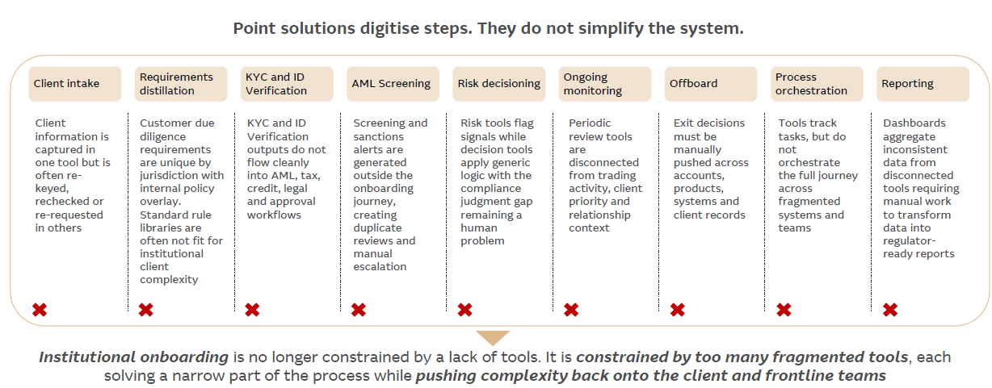

Slide 5
